Slide 1

Connecttel CUSTOMER CHURN PROJECT
By Uzoma Ewurum

Slide 2
PROJECT OVERVIEW
BACKGROUND
EXPLORATIVE DATA ANALYSIS
SUPERVISED MACHINE LEARNING

Slide 3
Background

Slide 4
PROBLEM STATEMENT
OBJECTIVE
EXPECTATION
ConnectTel is a Telecommunication company with the pressing need to address CUSTOMER CHURN which poses threat to its business sustainability and growth
To develop a CUSTOMER CHURN PREDICTION SYSTEM leveraging advanced data analytics and machine learning
To reduce customer attrition, enhance customer loyalty and maintain a competitive edge in a highly dynamic and competitive telecommunication industry

Slide 5
Explorative Data Analysis

Slide 6
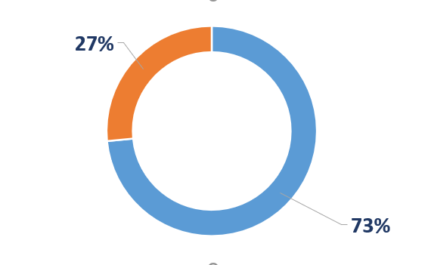
CUSTOMER CHURN
7,043
5,174
1,869
Total Customers
Remaining Customers
Customer Churn

Slide 7
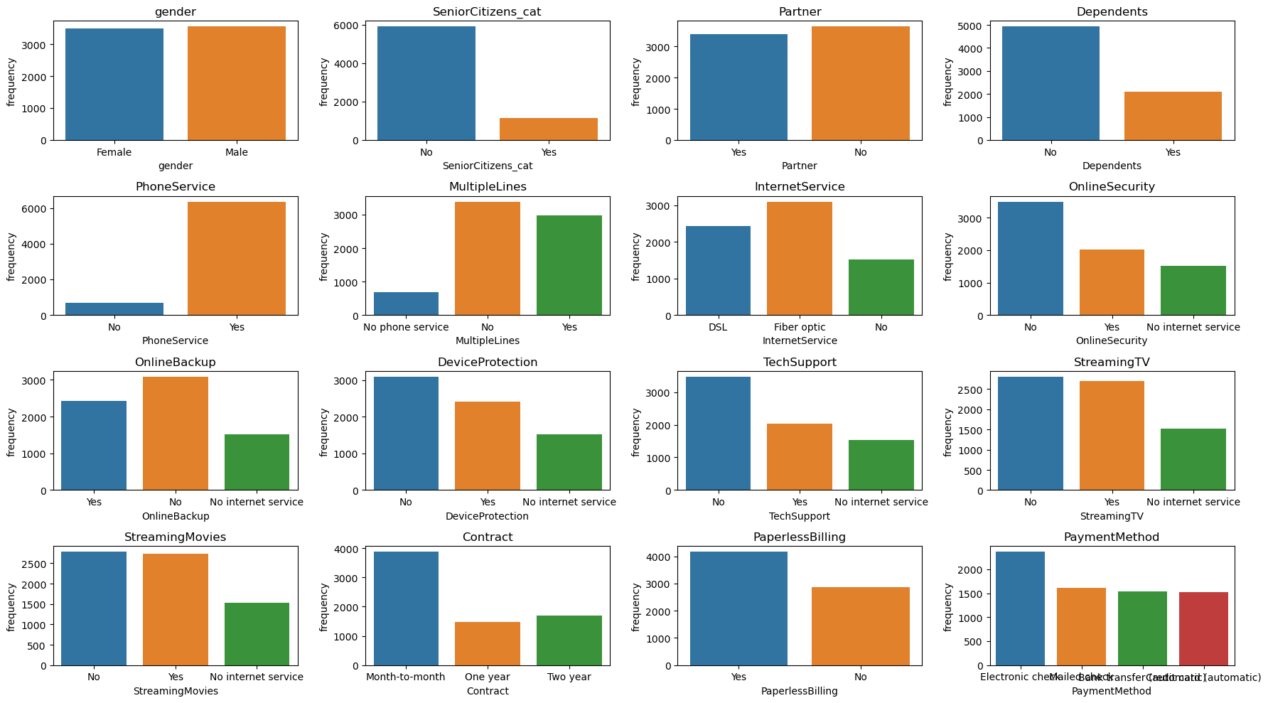
CATEGORICAL DATA OVERVIEW

Slide 8
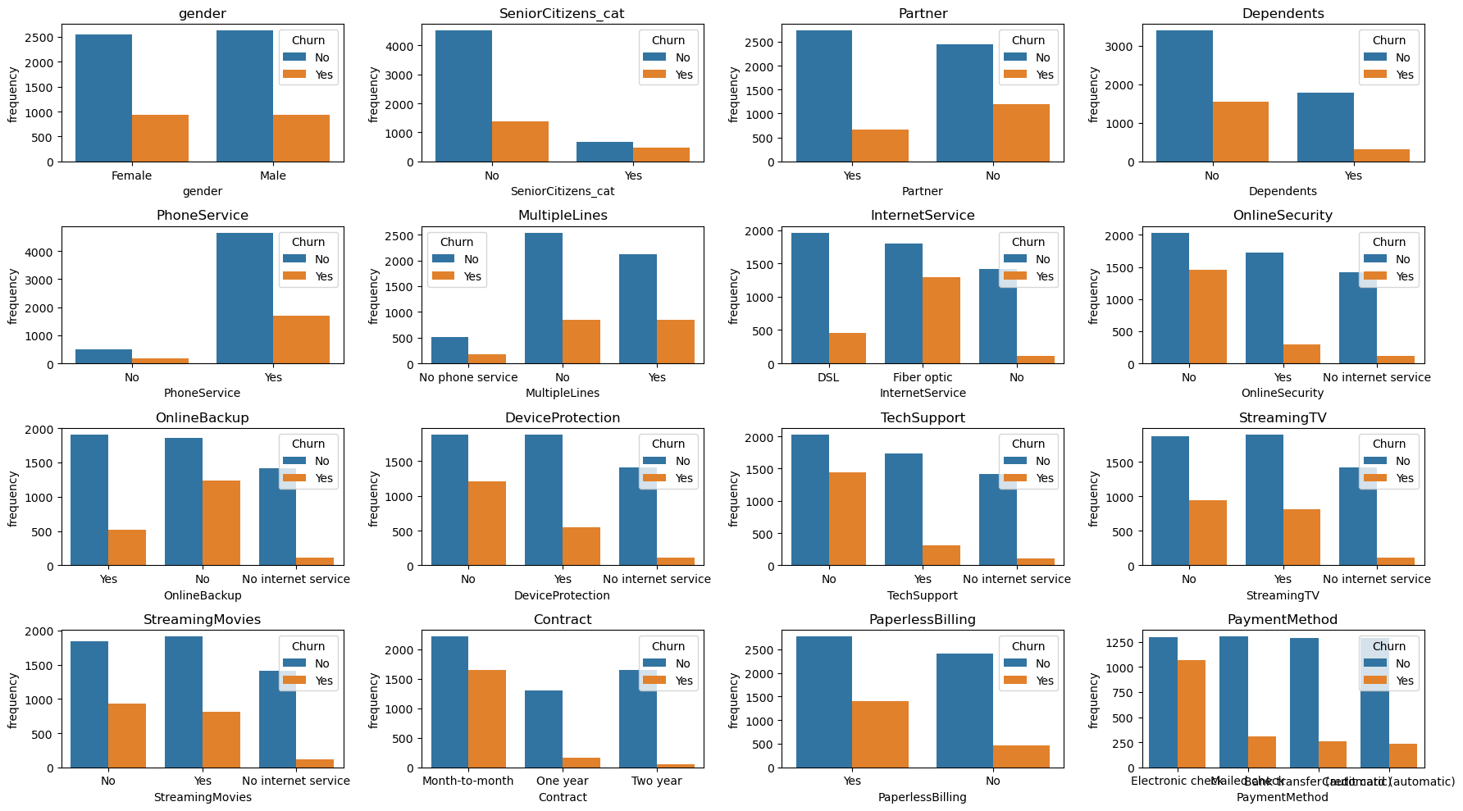
CATEGORICAL DATA BY CUSTOMER CHURN

Slide 9
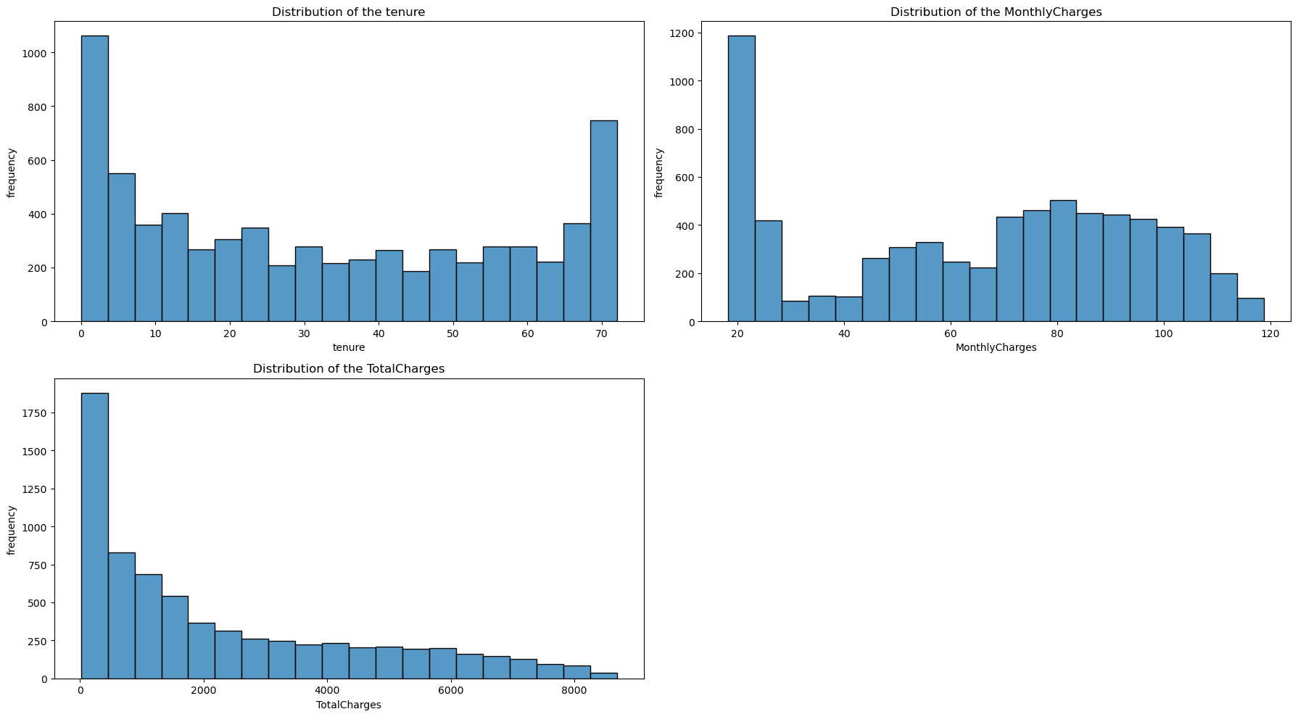
NUMERICAL DATA OVERVIEW

Slide 10
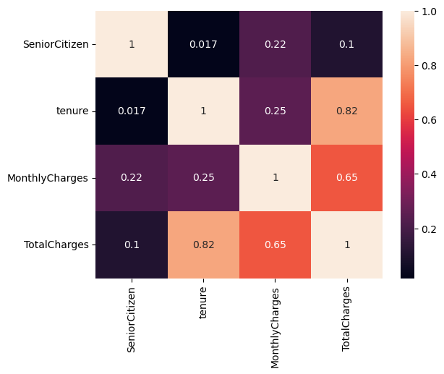
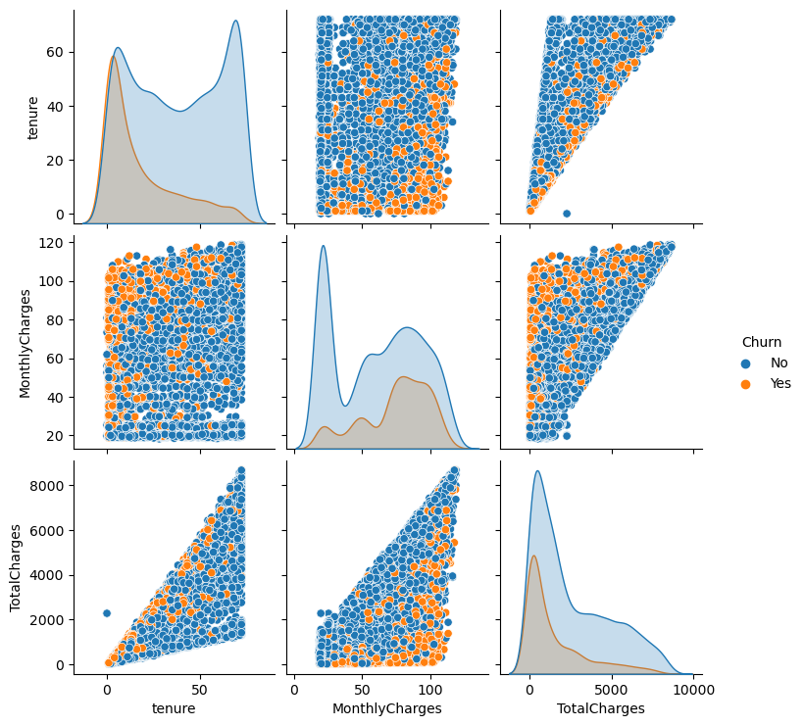
NUMERICAL DATA (ANALYSIS)
Relationship
By Customer Churn

Slide 11
KEY INSIGHTS
Total number of records was 7043, out of which they recorded a 26% (1864) churning
Most Customers (83%) were not Senior Citizens
Most Customers (70%) had no Dependents
Most Customers (90%) had Phone Service
Most Customers (43%) use fibre optics for internet service
49% for most of the customers had no online security
44% for most of the customers had no online backup
44% for most of the customers had no Device Protection
49% for most of the customers had no tech support
55% for most of the customers were on a month to month contract
34% for most of the customers used electronic check
Most of the customer that churned
Used fibre optics
had no online security
had no device protection
had no online backup
had no tech support
were on a month to month contract
used electronic check
Total Charges and Tenure had a strong positive correlation of 0.85 i.e Tenure increases with Total Charges
Total Charges and Monthly had a positive correlation as well of 0.65

Slide 12
Machine Learning

Slide 13
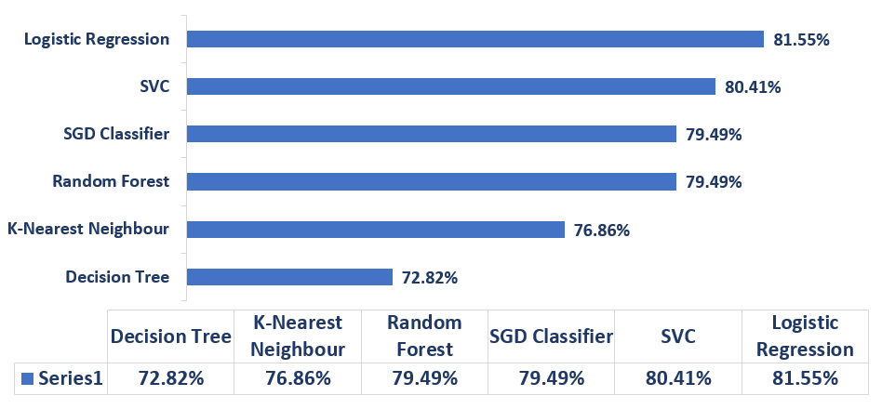
MODEL EVALUATION (Accuracy)

Slide 14
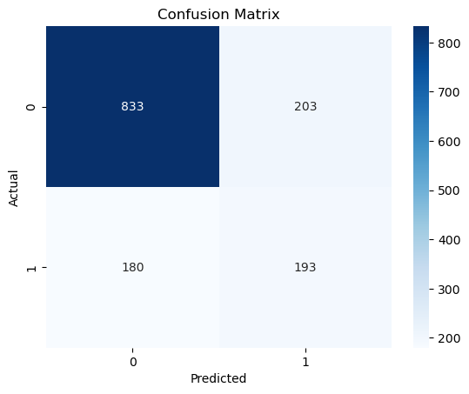

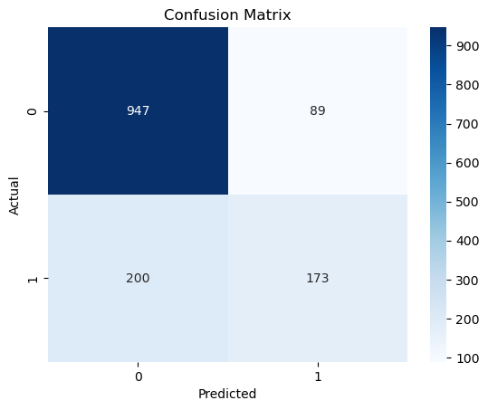


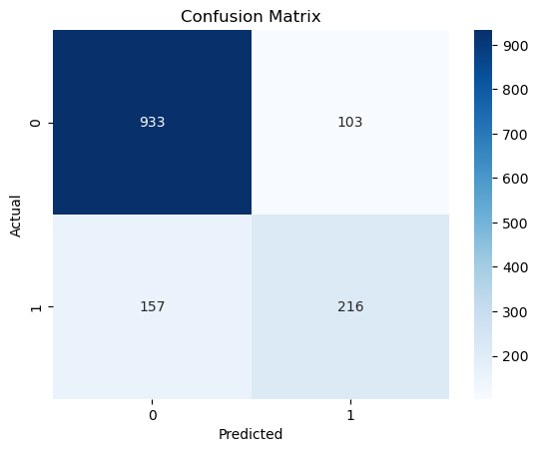
MODEL EVALUATION (Confusion Matrix)
Decision Tree
K-Nearest Neighbour
Random Forest
SGD Classifier
SVC
Logistic Regression

Slide 15
Conclusion & Recommendations
Optimize their internet fibre optic service.
Encourage customers who have internet service to equally have an online security, online backup and device protection
Provide Tech support
Regular Promotions to encourage customers to move from month to month contract to either one or two years’ plan

